Slide 1


Wireless and Mobile Networks
Dr. Muazzam A. Khan

Slide 2
Wireless Network: Base Station
Base station
Typically connected to wired network
Relay responsible for sending packets between wired network and wireless host(s) in its “area”
E.g., cell towers, 802.11 access points
network
infrastructure

Slide 3
Wireless Network: Infrastructure
Network infrastructure
Larger network with which a wireless host wants to communicate
Typically a wired network
Provides traditional network services
May not always exist
network
infrastructure

Slide 4
Scenario #1: Infrastructure Mode
Infrastructure mode
Base station connects mobiles into wired network
Network provides services (addressing, routing, DNS)
Handoff: mobile changes base station providing connection to wired network
network
infrastructure

Slide 5
Scenario #2: Ad Hoc Networks
Ad hoc mode
No base stations
Nodes can only transmit to other nodes within link coverage
Nodes self-organize and route among themselves

Slide 6
Infrastructure vs. Ad Hoc
Infrastructure mode
  Wireless hosts are associated with a base station
  Traditional services provided by the connected network
  E.g., address assignment, routing, and DNS resolution
Ad hoc networks
  Wireless hosts have no infrastructure to connect
  Hosts themselves must provide network services
Similar in spirit to the difference between
  Client-server communication
  Peer-to-peer communication

Slide 7
Different Types of Wireless Networks
 | Infrastructure-based | Infrastructure-less
Single hop | Base station connected to larger wired network (e.g., WiFi wireless LAN, and cellular telephony networks) | No wired network; one node coordinates the transmissions of the others (e.g., Bluetooth, and ad hoc 802.11)
Multi-hop | Base station exists, but some nodes must relay through other nodes (e.g., wireless sensor networks, and wireless mesh networks | No base station exists, and some nodes must relay through others (e.g., mobile ad hoc networks, like vehicular ad hoc networks)

Slide 8
WiFi: 802.11 Wireless LANs

Slide 9
Wireless Network: Wireless Link
Wireless link
Typically used to connect mobile(s) to base station
Also used as backbone link
Multiple access protocol coordinates link access
network
infrastructure

Slide 10
Wireless Network: Wireless Hosts
Wireless host
Laptop, PDA, IP phone
Run applications
May be stationary (non-mobile) or mobile
network
infrastructure

Slide 11
802.11 LAN Architecture
Access Point (AP)
  Base station that communicates with the wireless hosts
Basic Service Set (BSS)
  Coverage of one AP
  AP acts as the master
  Identified by an “network name” known as an SSID
Internet
hub, switch
or router
AP
BSS 1
AP
BSS 2
SSID: Service Set Identifier

Slide 12
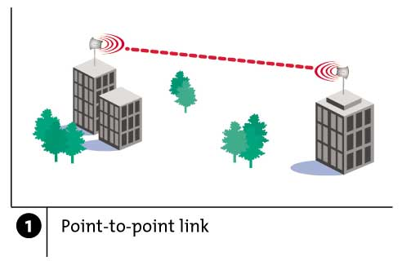
Wireless Links: High Bit Error Rate
Decreasing signal strength
  Disperses as it travels greater distance
  Attenuates as it passes through matter

Slide 13
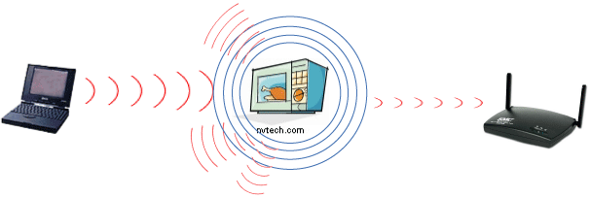
Wireless Links: High Bit Error Rate
Interference from other sources
  Radio sources in same frequency band
  E.g., 2.4 GHz wireless phone interferes with 802.11b wireless LAN
  Electromagnetic noise (e.g., microwave oven)

Slide 14
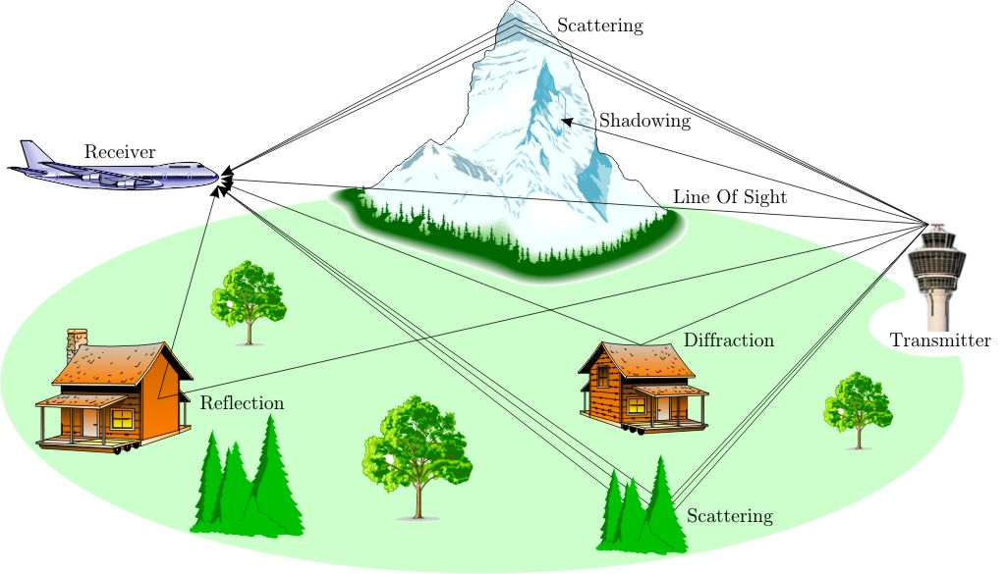
Wireless Links: High Bit Error Rate
Multi-path propagation
  Electromagnetic waves reflect off objects
  Taking many paths of different lengths
  Causing blurring of signal at the receiver
receiver
transmitter

Slide 15
Dealing With Bit Errors
Wireless vs. wired links
  Wired: most loss is due to congestion
  Wireless: higher bit-error rate
Dealing with high bit-error rates
  Sender could increase transmission power
    Requires more energy (bad for battery-powered hosts)
    Creates more interference with other senders
  Stronger error detection and recovery
    More powerful error detection codes are required
    Link-layer retransmission of corrupted frames

Slide 16
Wireless Links: Broadcast Limitations
Wired broadcast links
  E.g., Ethernet bridging, in wired LANs
  All nodes receive transmissions from all other nodes
Wireless broadcast:
C
A and B hear each other
B and C hear each other
But, A and C do not
So, A and C are unaware
of their interference at B.
B
A

Slide 17
Wireless Links: Broadcast Limitations
Wired broadcast links
  All nodes receive transmissions from all other nodes
Wireless broadcast: fading over distance
A
B
C
A and B hear each other
B and C hear each other
But, A and C do not
So, A and C are unaware
of their interference at B.
A’s signal
strength
C’s signal
strength
space

Slide 18
Example Wireless Link Technologies
Data networks
  Indoor (10-30 meters)
    802.11n: 200 Mbps
    802.11a and g: 54 Mbps
    802.11b: 5-11 Mbps
    802.15.1: 1 Mbps
  Outdoor (50 meters to 20 kmeters)
    802.11 and g point-to-point: 54 Mbps
    WiMax: 5-11 Mbps
Cellular networks, outdoors
  3G enhanced: 4 Mbps
  3G: 384 Kbps
  2G: 56 Kbps

Slide 19
Channels and Association
Multiple channels at different frequencies
  Network administrator chooses frequency for AP
  Interference if frequency is same as neighboring AP
Access points send periodic beacon frames
  Containing AP’s name (SSID) and MAC address
  Host scans channels, listening for beacon frames
  Host selects an access point to associate with
Beacon frames from APs
Associate request from host
Association response from AP

Slide 20
802.11: passive/active scanning
BBS 1
BBS 2
BBS 1
BBS 2
AP 1
AP 2
AP 1
1
AP 2
1
1
2
2
2
3
3
4
H1
H1
Active Scanning:
Request frame broadcast from H1
Response frame sent from APs
Association Request frame sent: H1 to selected AP
Association Response frame sent: H1 to selected AP
Passive Scanning:
Beacon frames sent from APs
Association Request frame sent: H1 to selected AP
Association Response frame sent: H1 to selected AP
20
Notes:
20

Slide 21
Mobility Within the Same Subnet
H1 remains in same IP subnet
  IP address of the host can remain same
  Ongoing data transfers can continue uninterrupted
H1 recognizes the need to change
  H1 detects a weakening signal
  Starts scanning for stronger one
Changes APs with same SSID
  H1 disassociates from one
  And associates with other
Switch learns new location
  Self-learning mechanism
router
hub or
switch
BBS 1
AP 1
AP 2
H1
BBS 2

Slide 22
CSMA: Carrier Sense, Multiple Access
Multiple access: channel is shared medium
  Station: wireless host or access point
  Multiple stations may want to transmit at same time
Carrier sense: sense channel before sending
  Station doesn’t send when channel is busy
  To prevent collisions with ongoing transfers
  But, detecting ongoing transfers isn’t always possible
A
B
C
C
A’s signal
strength
C’s signal
strength
B
A
space

Slide 23
CA: Collision Avoidance, Not Detection
Collision detection in wired Ethernet
  Station listens while transmitting
  Detects collision with other transmission
  Aborts transmission and tries sending again
Problem #1: cannot detect all collisions
  Hidden terminal problem
Problem #2: listening while sending
  Strength of received signal is much smaller/higher
  -- Exposed Terminal Problem
So, 802.11 does not do collision detection

Slide 24
Medium Access Control in 802.11
Collision avoidance, not detection
  Once a station starts transmitting,
  Need More aggressive collision-avoidance techniques
  E.g., waiting a little after sensing an idle channel
  To reduce likelihood two stations transmit at once
Link-layer acknowledgment and retransmission
  CRC to detect errors
  Receiving station sends an acknowledgment
  Sending station retransmits if no ACK is received
  Giving up after a few failed transmissions

Slide 25
Medium Access Control Protocol Issues
Many issues need to be addressed in order to design an efficient MAC protocol
Hidden Terminal Problem
  Station A can hear B but not C, and station C can hear station B but not A
  First, assume A is sending to B
  When C is ready to transmit, it does not detect carrier and thus commences transmission; this produces a collision at B
A
B
C

Slide 26
Hidden Terminal Problem
A
B
C
Hidden terminals
  A sends to B, C cannot detect A’s transmission
  C wants to send to B, C senses a “free” medium (CS fails)
  Collision at B, A cannot detect the collision (CD fails)
  A is “hidden” for C

Slide 27
Exposed Terminal Problem
A
B
C
D
Exposed terminals
  B sends to A, C wants to send to D
  C senses carrier, finds medium in use and has to wait
  A is outside the radio range of C, therefore waiting is not necessary
  C is “exposed” to B

Slide 28
Multiple Access with Collision Avoidance (MACA)
MACA uses signaling packets for collision avoidance
  RTS (request to send)
  -Sender request the right to send from a receiver with a short RTS packet before it sends a data packet
  CTS (clear to send)
    -Receiver grants the right to send as soon as it is ready to receive
Signaling packets contain
  Sender address
  Receiver address
  Duration

Slide 29
MACA Solutions
MACA avoids the problem of hidden terminals
  A and C want to send to B
  A sends RTS first
  C waits after receiving
  CTS from B
MACA avoids the problem of exposed terminals
  B wants to send to A, C to another terminal
  Now C does not have
  to wait, as it cannot
  receive CTS from A
RTS
A
B
C
CTS
CTS
RTS
RTS
A
B
C
CTS

Slide 30
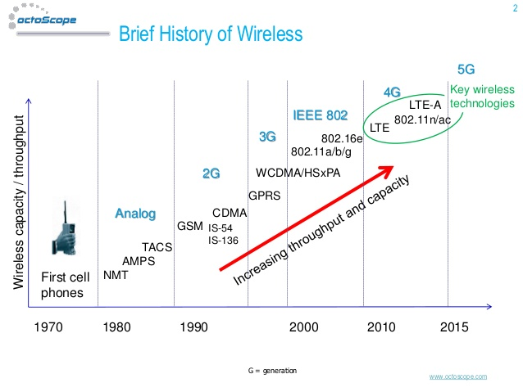
Evolution of Wireless Communication

Slide 31
Characteristics of selected wireless link standards
54 Mbps
802.11{a,g}
5-11 Mbps
.11 p-to-p link
802.11b
1 Mbps
802.15
3G
384 Kbps
UMTS/WCDMA, CDMA2000
2G
56 Kbps
IS-95 CDMA, GSM
Indoor
10 – 30m
Outdoor
50 – 200m
Mid range
outdoor
200m – 4Km
Long range
outdoor
5Km – 20Km

Slide 32
Why Ad Hoc Networks ?
Setting up of fixed access points and backbone infrastructure is not always viable
  Infrastructure may not be present in a disaster area or war zone
  Infrastructure may not be practical for short-range radios; Bluetooth (range ~ 10m)
Ad hoc networks:
  Do not need backbone infrastructure support
  Are easy to deploy
  Useful when infrastructure is absent, destroyed or impractical

Slide 33
Comparisons between Cellular and Ad Hoc Wireless Networks (I)
Cellular Networks | Ad Hoc Wireless Networks
Fixed infrastructure-based | Infrastructureless
Guaranteed bandwidth (designed for voice traffic) | Shared radio channel (more suitable for best-effort data traffic)
Centralized routing | Distributed routing
Circuit-switched (evolved toward packet switching) | Packet-switched (evolving toward emulation of circuit switching)
Seamless connectivity (low call drops during handoffs) | Frequent path breaks due to mobility
High cost and time of deployment | Quick and cost-effective deployment
Application domains include mainly civilian and commercial sectors | Application domains include battlefields, emergency search and rescue operations, and collaborative computing

Slide 34
Comparisons between Cellular and Ad Hoc Wireless Networks (II)
Cellular Networks | Ad Hoc Wireless Networks
High cost of network maintenance (backup power source, staffing, etc.) | Self-organization and maintenance properties are built into the network
Mobile hosts are of relatively low complexity | Mobile hosts require more intelligence (should have a transceiver as well as routing/switching capability)
Major goals of routing and call admission are to maximize the call acceptance ratio and minimize the call drop ratio | Main aim of routing is to find paths with minimum overhead and also quick reconfiguration of broken paths
Widely deployed and currently in the fourth generation of evolution | Several issues are to be addressed for successful commercial deployment even though widespread use exists in defense

Slide 35
Host Mobility

Slide 36
Varying Degrees of User Mobility
Moves only within same access network
  Single access point: mobility is irrelevant
  Multiple access points: only link-link layer changes
  Either way, users is not mobile at the network layer
Shuts down between changes access networks
  Host gets new IP address at the new access network
  No need to support any ongoing transfers
  Applications have become good at supporting this
Maintains connections while changing networks
  Surfing the ‘net while driving in a car or flying a plane
  Need to ensure traffic continues to reach the host

Slide 37
Maintaining Ongoing Transfers
Seamless transmission to a mobile host
A
B

Slide 38

E.g., Keeping Track of Mobile Friends
Sending a letter to a friend who moves often
  How do you know where to reach him?
Option #1: have him update you
  Friend contacts you on each move
  So you can mail him directly
Option #2: ask his parents when needed
  Parents serve as “permanent address”
  They can forward your letter to him
  Or, they can update you

Slide 39
Letting Routing Protocol Handle It
Mobile node has a single, persistent address
Address injected into routing protocol (e.g., OSPF)
A
B
12.34.45.0/24
12.34.45.7/32
Mobile host with IP address 12.34.45.7

Slide 40
Example: Boeing Connexion Service
Boeing Connexion service
  Mobile Internet access provider
  WiFi “hot spot” at 35,000 feet moving 600 mph
Communication technology
  Antenna on the plane to leased satellite transponders
  Ground stations serve as Internet gateways
Using BGP for mobility
  IP address block per airplane
  Ground station advertises into BGP

Slide 41




Example: Boeing Connexion Service
12.78.3.0/24
Internet

Slide 42
Summary: Letting Routing Handle It
Advantages
  No changes to the end host
  Traffic follows an efficient path to new location
Disadvantages
  Does not scale to large number of mobile hosts
    Large number of routing-protocol messages
    Larger routing tables to store smaller address blocks
Alternative
  Mobile IP

Slide 43
Home Network and Home Agent
Home network: permanent “home” of mobile
(e.g., 128.119.40/24)
Home agent: entity that will perform mobility functions on behalf of mobile, when mobile is remote
wide area network
Permanent address: address in home network, can always be used to reach mobile
e.g., 128.119.40.186
correspondent
Correspondent: wants to communicate with mobile

Slide 44
Visited Network and Care-of Address
Visited network: network in which mobile currently resides (e.g., 79.129.13/24)
Permanent address: remains constant (e.g., 128.119.40.186)
Care-of-address: address in visited network.
(e.g., 79,129.13.2)
wide area network
Home agent: entity in visited network that performs mobility functions on behalf of mobile.
Correspondent: wants to communicate with mobile

Slide 45
Mobility: Registration
visited network
home network
1
2
wide area network
mobile contacts foreign agent on entering visited network
foreign agent contacts home agent home: “this mobile is resident in my network”
Foreign agent knows about mobile
Home agent knows location of mobile

Slide 46
Mobility via Indirect Routing
foreign agent receives packets, forwards to mobile
home agent intercepts packets, forwards to foreign agent
visited
network
home
network
3
wide area network
2
1
correspondent addresses packets using home address of mobile
4
mobile replies directly to correspondent

Slide 47
Indirect Routing: Efficiency Issues
Mobile uses two addresses
  Permanent address: used by correspondent (making mobile’s location is transparent to correspondent)
  Care-of-address: used by the home agent to forward datagrams to the mobile
Mobile may perform the foreign agent functions
Triangle routing is inefficient
  E.g., correspondent and mobile in the same network

Slide 48
Mobility via Direct Routing
foreign agent receives packets, forwards to mobile
correspondent forwards to foreign agent
visited
network
home
network
4
wide area network
2
3
correspondent requests, receives foreign address of mobile
1
4
mobile replies directly to correspondent
No longer transparent to the correspondent

Slide 49
Impact on Higher-Layer Protocols
Wireless and mobility change path properties
  Wireless: higher packet loss, not from congestion
  Mobility: disruptions, and changes in RTT
Logically, impact should be minimal …
  Best-effort service model remains unchanged
  TCP and UDP can (and do) run over wireless, mobile
But, performance definitely is affected
  TCP treats packet loss as a sign of congestion
  TCP tries to estimate the RTT to drive retransmissions
  TCP does not perform well under out-of-order packets
Internet not designed with these issues in mind

Slide 50
Conclusions
Wireless
  Already a major way people connect to the Internet
  Gradually becoming more than just an access network
Mobility
  Today’s users tolerate disruptions as they move
  Tomorrow’s users expect seamless mobility
Challenges the design of network protocols
  Wireless breaks the abstraction of a link
  Mobility breaks association of address and location
  Higher-layer protocols don’t perform as well

